Slide 1
Workshop 3
Advanced Analytics and Applications [AAA]
Information Systems for Sustainable Society (is3) | WiSo Faculty | Univ.-Prof. Dr. Wolfgang Ketter | 4/27/21

Slide 2
I
Revisiting Concepts from the Lecture
II
Calculating Linear Decision Boundaries
III
Programming

Slide 3
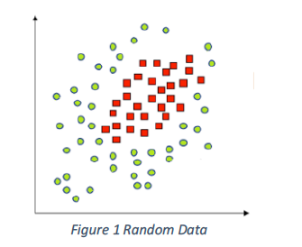
Revisit Concepts
Question 1.1: Linear non-separable data
Our objective is to find a classifier for the data (on the left). Why is a linear classifier ineffective for such data?

Slide 4
Revisit Concepts
Question 1.1: Linear non-separable data
Our objective is to find a classifier for the data (on the left). Why is a linear classifier ineffective for such data?
Solution: Because a typical linear classifier can only separate data using a hyperplane (several solutions might exists). Hyperplanes are a flat subspace of the originating Euclidean space. Curved or any other subspaces cannot be calculated with classical linear classifiers.
For the data, there exists no hyperplane to separate the red from the green dots.

Slide 5
Revisit Concepts
Question 1.2: Linear non-separable data
Could we train and use a decision tree instead?

Slide 6
Revisit Concepts
Question 1.2: Linear non-separable data
Could we train and use a decision tree instead?
Solution: Technically, yes - of course. However, decision trees partition the space and the data into fine rectangles (i.e., decision boundaries). If our data is sampled from a circular distribution (e.g., 2D Gaussian), decision tree might struggle to find clear cut (or precise) decision boundaries.

Slide 7
Revisit Concepts
Question 1.2: Linear non-separable data
How would a classifier using a RBF kernel approach this classification task?
Solution: We have to data classes: red (-1) and green data (+1) points. Assign each data point an gaussian-like exponential function. Then, we learn (i.e., interpolate) a high (theoretically infinite) dimensional compound function using the kernels assigned to the data points; red kernels are pointed towards negative values, green kernels towards positive values. Thus, our data becomes linearly separable in an infinite dimensional space.

Slide 8
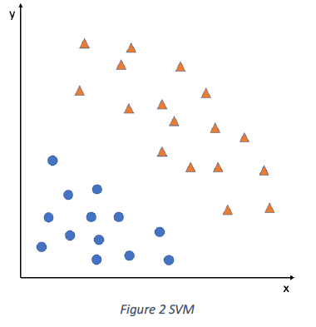
Revisit Concepts
Question 2.1: Support Vector Machines
How would you intuitively separate the data?

Slide 9
Revisit Concepts
Question 2.1: Support Vector Machines
How would you intuitively separate the data?
Solution: Most humans intuitively place the separating line exactly between the blue and orange data points, with the distance of the line to both classes is typically more or less the same.

Slide 10
Revisit Concepts
Question 2.2: Support Vector Machines
Draw several linear classifiers that separate the data correctly.

Slide 11
Revisit Concepts
Question 2.2: Support Vector Machines
Draw several linear classifiers that separate the data correctly.
Solution: There are theoretically an infinite number of dividing lines.

Slide 12
Revisit Concepts
Question 2.2: Support Vector Machines
What would be the output of SVM?

Slide 13
Revisit Concepts
Question 2.2: Support Vector Machines
What would be the output of SVM?
Solution: The output of the SVM would resemble our intuition. A line that separate both data groups but also maximized the margin between the groups and the line.

Slide 14
Revisit Concepts
Question 2.2: Support Vector Machines
Briefly explain what happens when a support vector is moved?

Slide 15


Revisit Concepts
Question 2.2: Support Vector Machines
Briefly explain what happens when a support vector is moved?
Solution: The output of the SVM changes

Slide 16
Revisit Concepts
Question 2.2: Support Vector Machines
What happens when other than SV are moved?

Slide 17
Revisit Concepts
Question 2.2: Support Vector Machines
What happens when other than SV are moved?
Solution: Nothing

Slide 18
I
Revisiting Concepts from the Lecture
II
Calculating Linear Decision Boundaries
III
Programming

Slide 19
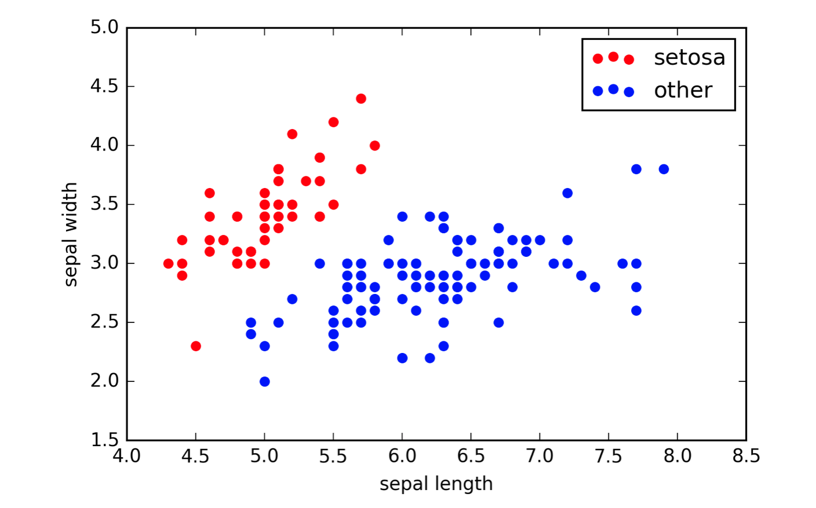
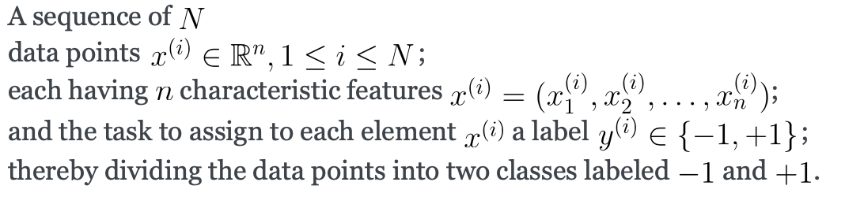
Revisit Concepts
Question 3.2: Perceptron Algorithm
Explain how the perceptron algorithm works.
Prerequisites:
Source: https://www.mathematik.uni-muenchen.de/%7Edeckert/teaching/SS18/sec-steps.html

Slide 20
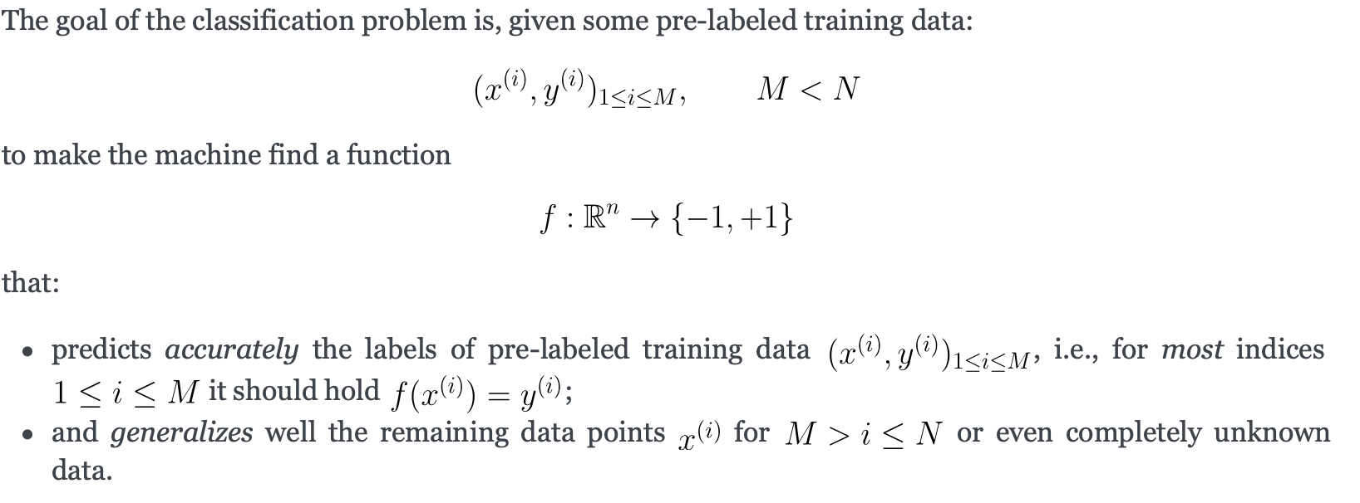
Revisit Concepts
Question 3.2: Perceptron Algorithm
Objective:
Source: https://www.mathematik.uni-muenchen.de/%7Edeckert/teaching/SS18/sec-steps.html

Slide 21
Revisit Concepts
Question 3.2: Perceptron Algorithm
Objective:
Source: https://www.mathematik.uni-muenchen.de/%7Edeckert/teaching/SS18/sec-steps.html

Slide 22
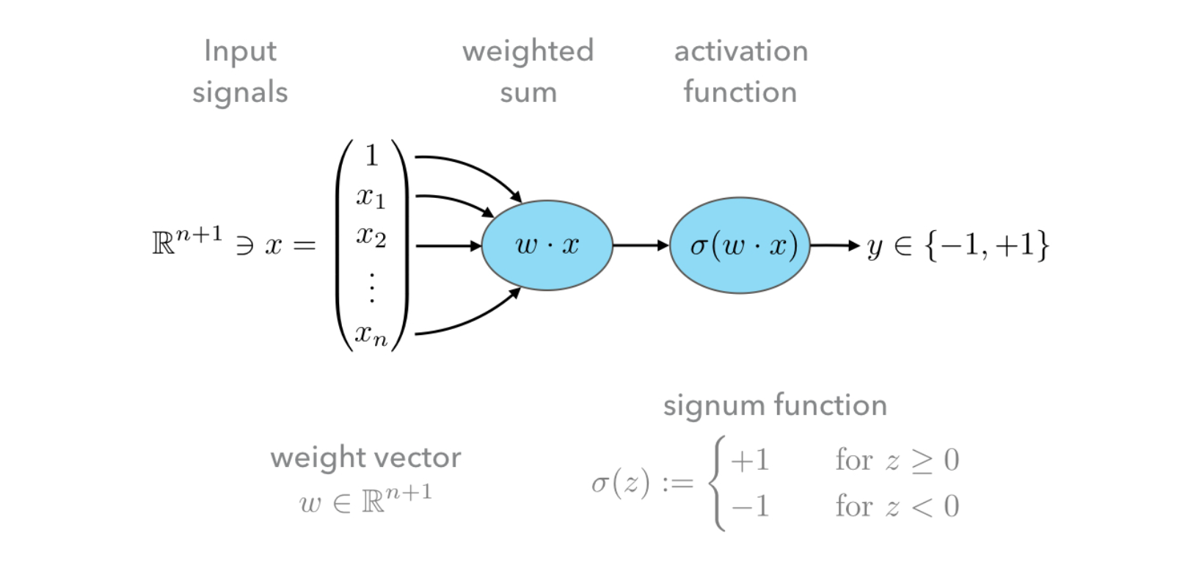
Revisit Concepts
Question 3.2: Perceptron Algorithm
Sketch of Perceptron Algorithm:
Source: https://www.mathematik.uni-muenchen.de/%7Edeckert/teaching/SS18/sec-steps.html

Slide 23
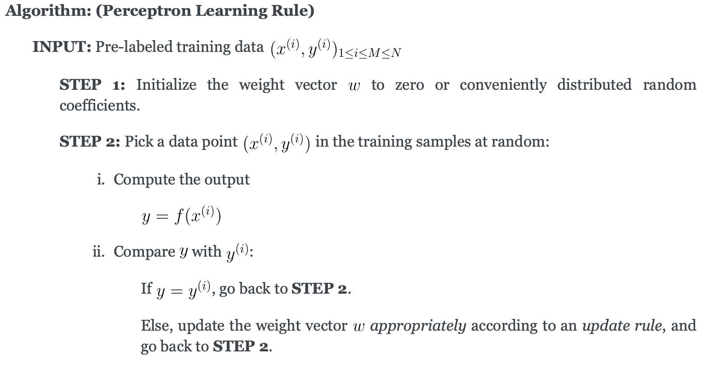
Revisit Concepts
Question 3.2: Perceptron Algorithm
Perceptron Learning Rule
Source: https://www.mathematik.uni-muenchen.de/%7Edeckert/teaching/SS18/sec-steps.html

Slide 24
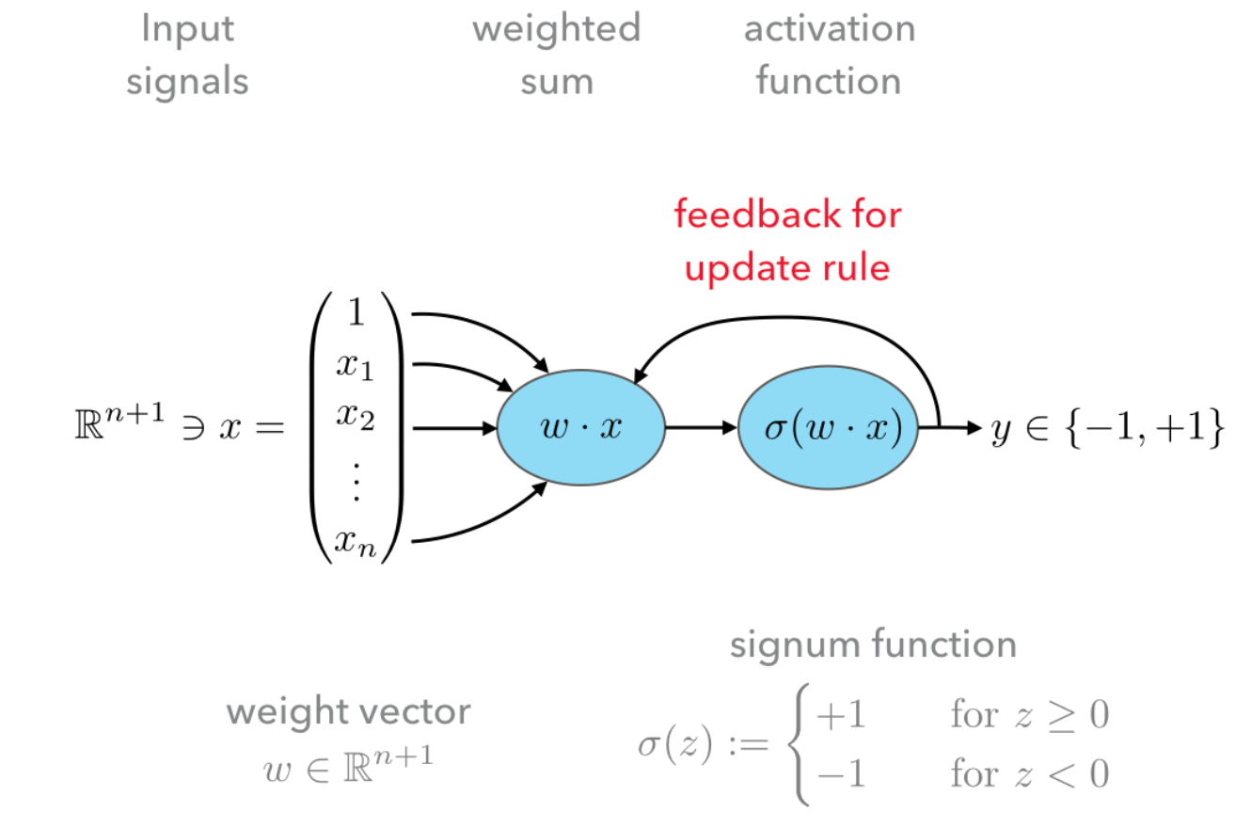
Revisit Concepts
Question 3.2: Perceptron Algorithm
Revisit the sketch: Feedback Loop
Source: https://www.mathematik.uni-muenchen.de/%7Edeckert/teaching/SS18/sec-steps.html

Slide 25
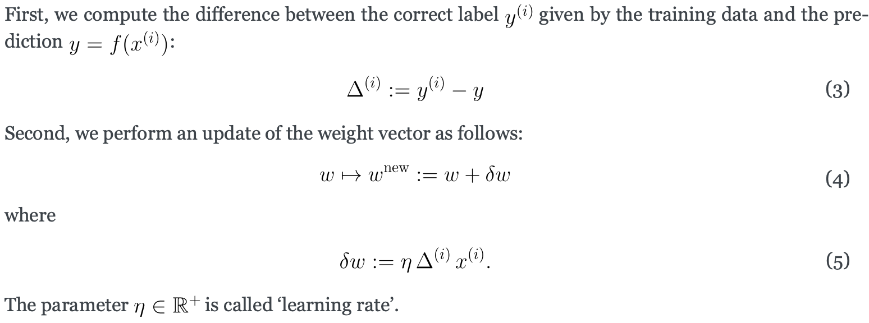
Revisit Concepts
Question 3.2: Perceptron Algorithm
The update rule
Source: https://www.mathematik.uni-muenchen.de/%7Edeckert/teaching/SS18/sec-steps.html

Slide 26
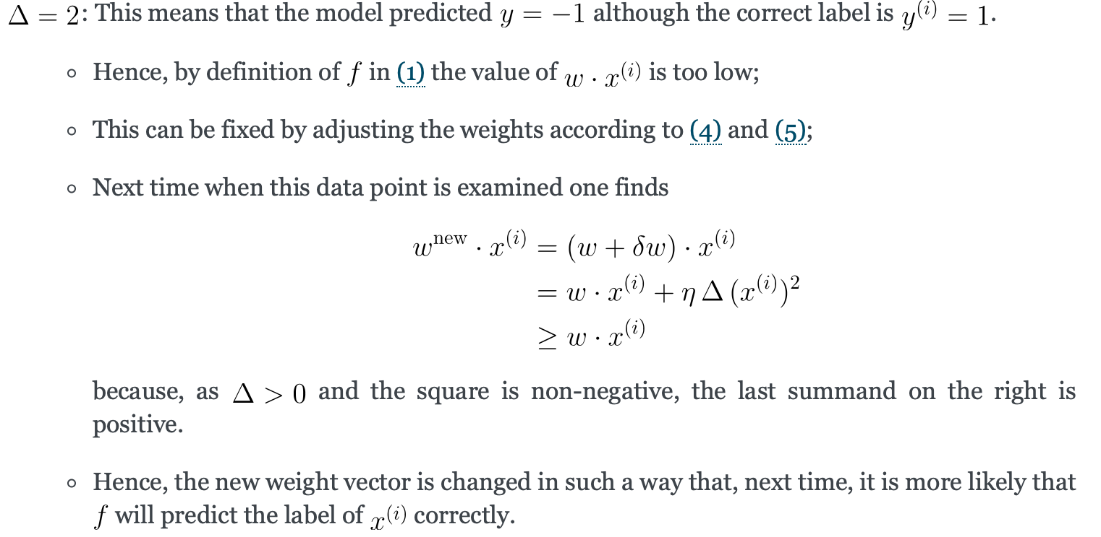
Revisit Concepts
Question 3.2: Perceptron Algorithm
The update rule: Case 1
Source: https://www.mathematik.uni-muenchen.de/%7Edeckert/teaching/SS18/sec-steps.html

Slide 27
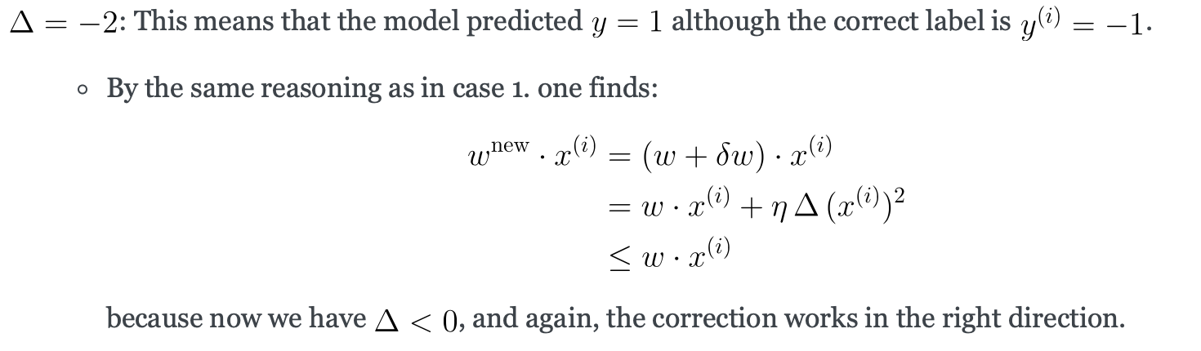
Revisit Concepts
Question 3.2: Perceptron Algorithm
The update rule: Case 2
Source: https://www.mathematik.uni-muenchen.de/%7Edeckert/teaching/SS18/sec-steps.html

Slide 28
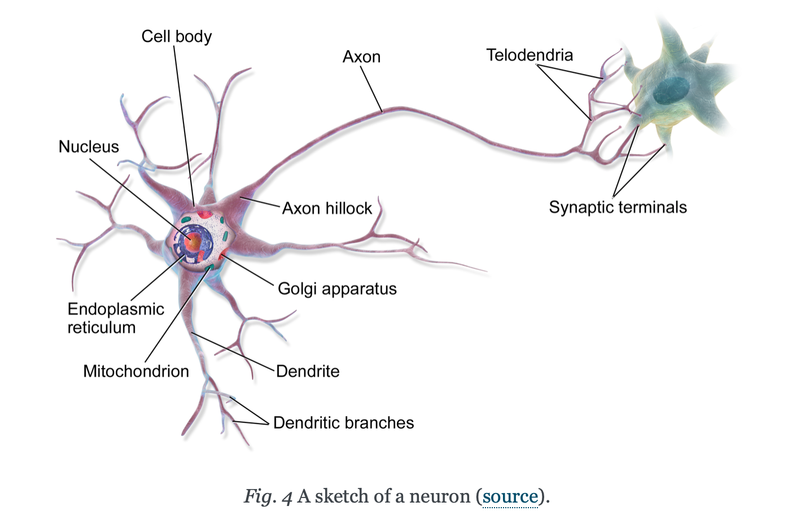
Revisit Concepts
Question 3.3: Perceptron Algorithm
What is the key difference between the perceptron algorithm and a svm classifier?
Solution: -Optimality condition (i.e., maximum margin) - Perceptron is an iterative algorithm which stops once one valid classifier has been found.
Source: https://www.mathematik.uni-muenchen.de/%7Edeckert/teaching/SS18/sec-steps.html

Slide 29
I
Revisiting Concepts from the Lecture
II
Calculating Linear Decision Boundaries
III
Programming

Slide 30
Contact
For general questions and enquiries on research, teaching, job openings and new projects refer to our website at www.is3.uni-koeln.de
For specific enquiries regarding this course contact us by sending an email to the IS3 teaching address at is3-teaching@wiso.uni-koeln.de

